Slide 1

I’ M SHALINI SINGH.
UI / UX SPECIALIST

Slide 2

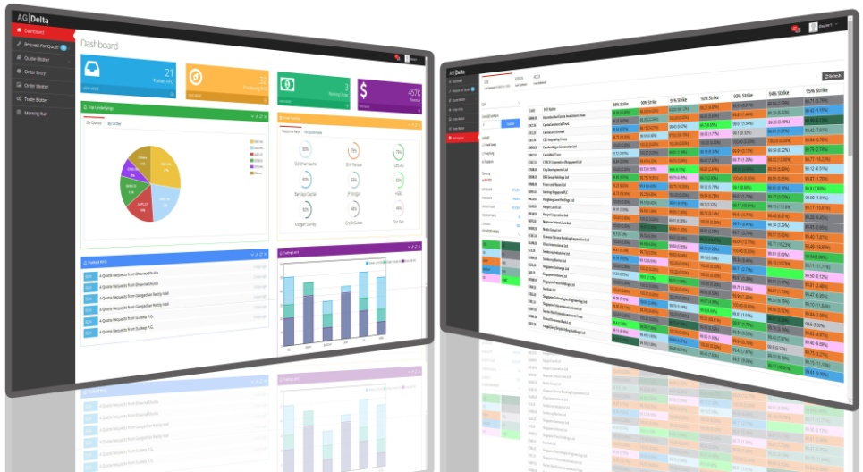

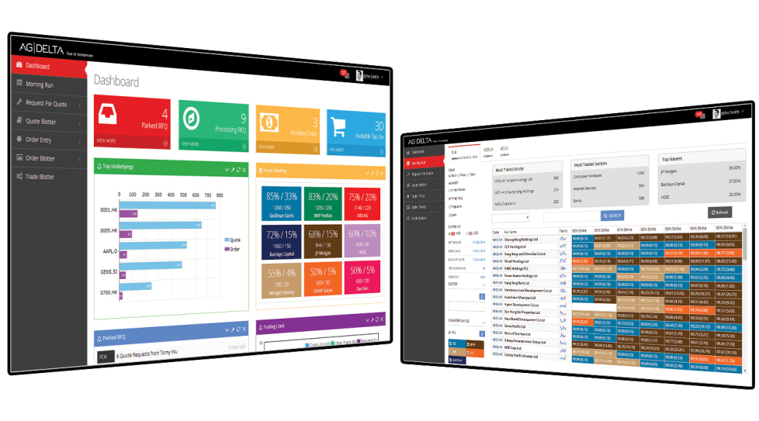
Visualization and Creation of Adv at AGDelta

Slide 3





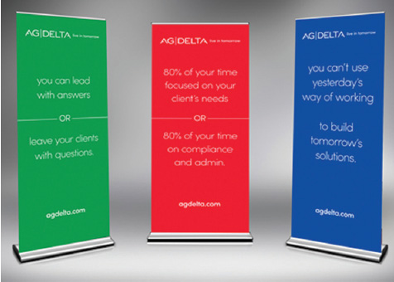


Banners Creation and cards Multilingual at AGDelta

Slide 4
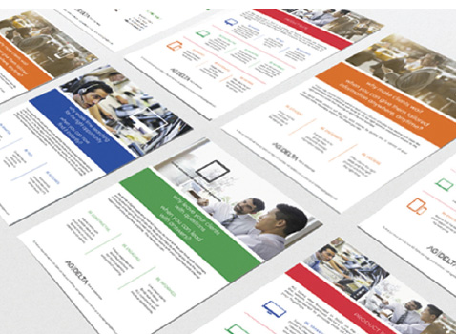
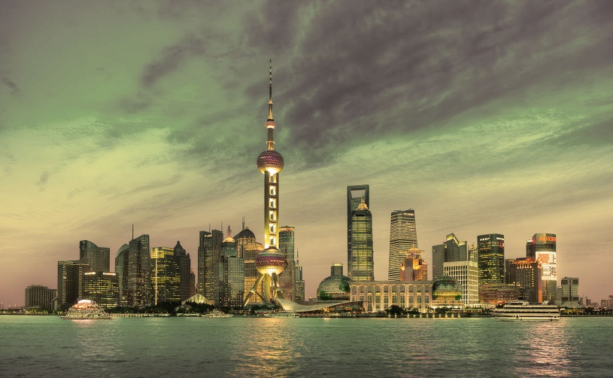

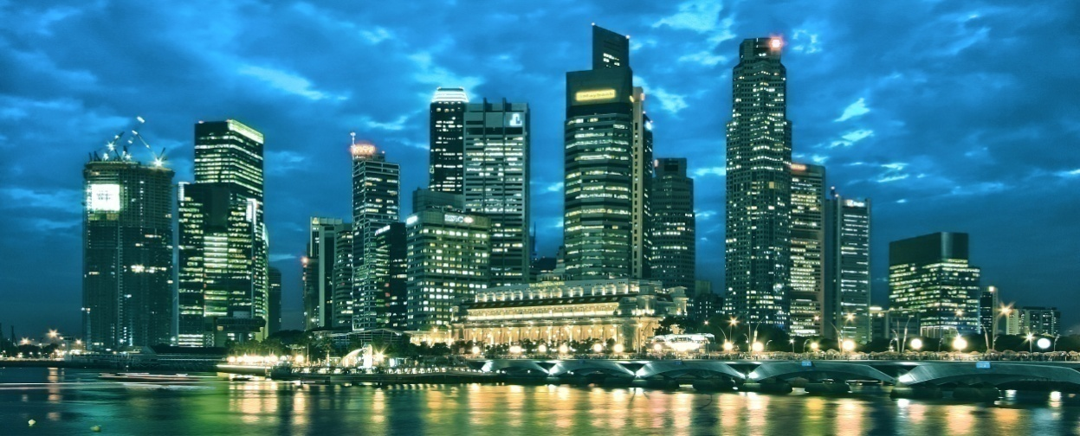
Skylines and brochure creation at AGDelta
China Skyline
HK Skyline
Singapore Skyline

Slide 5
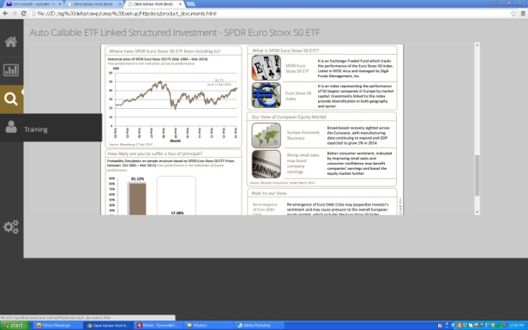
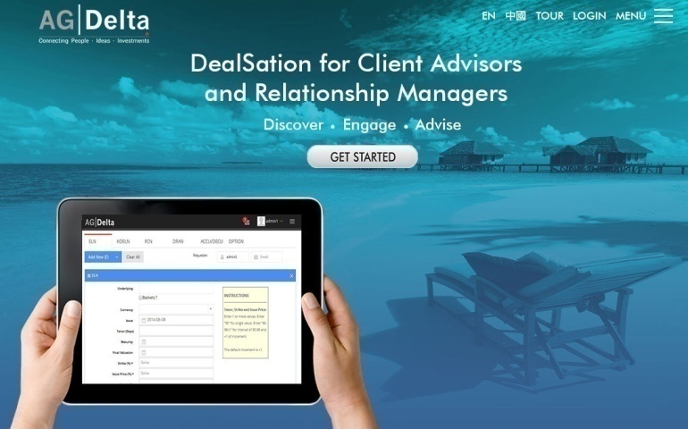
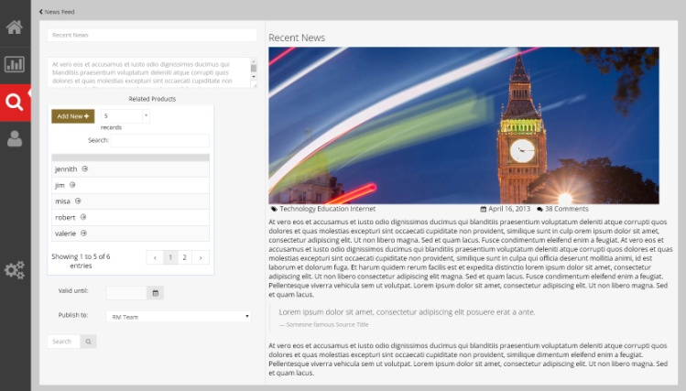
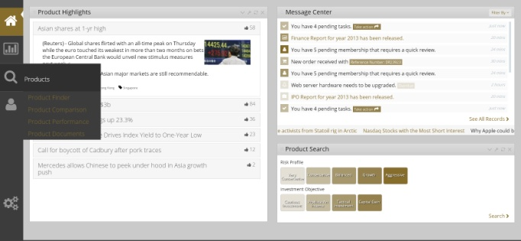
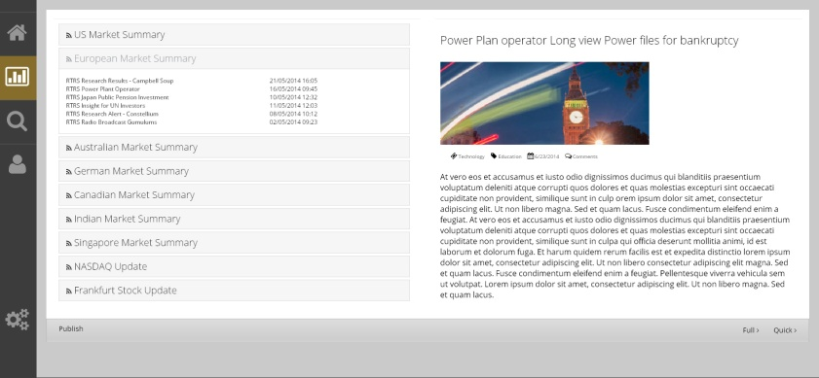
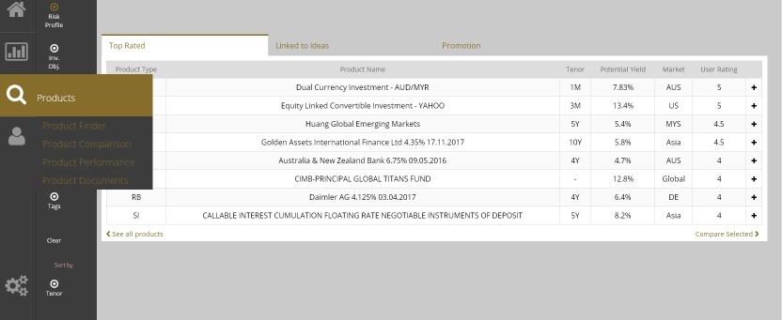
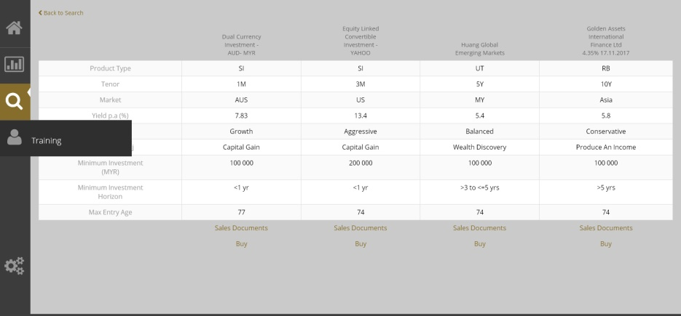
Proposed Android Apps UI as well as real code Design using HTML5, CSS3 and for a Bank

Slide 6

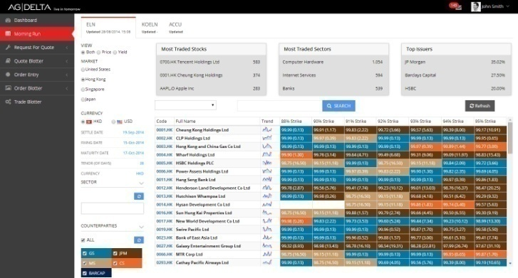
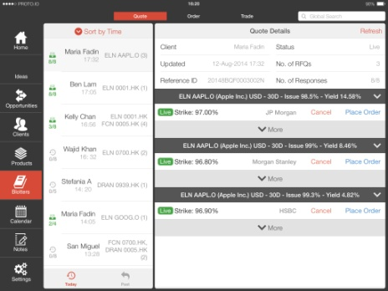
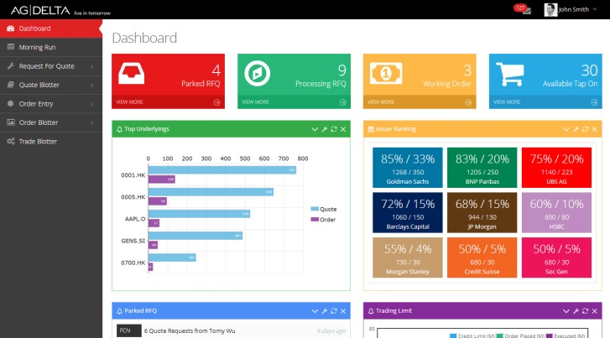
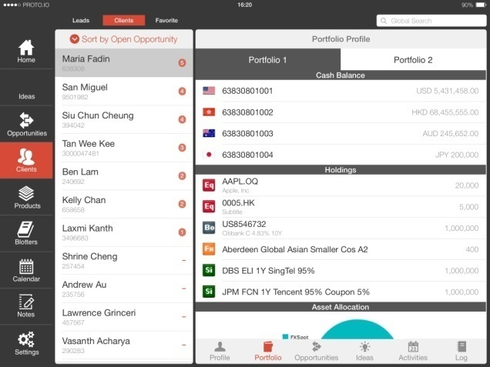
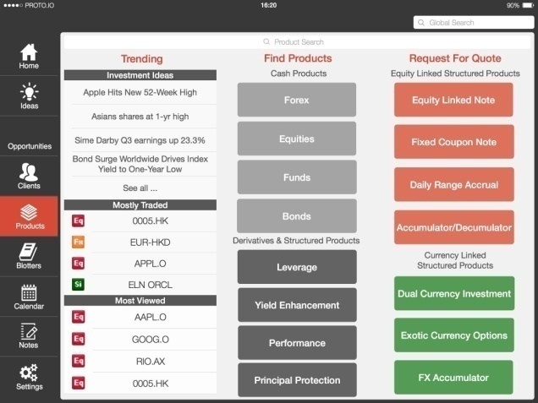
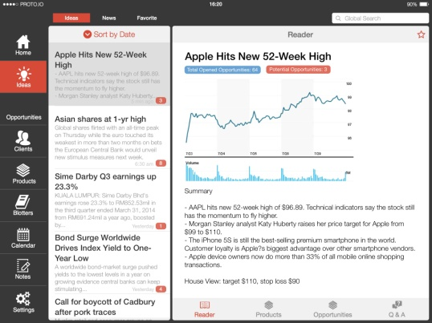
Apps UI as well as hard code generated in HTML5, CSS3 for the RM’s

Slide 7
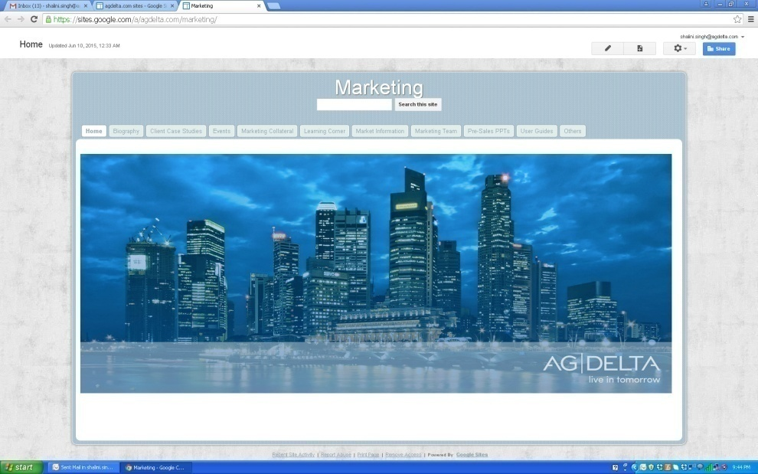
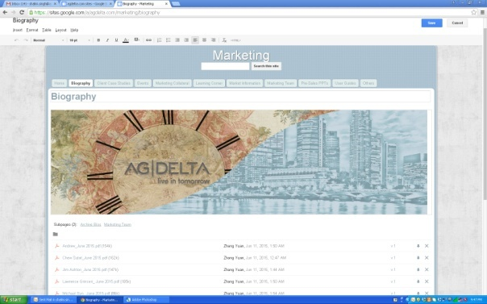
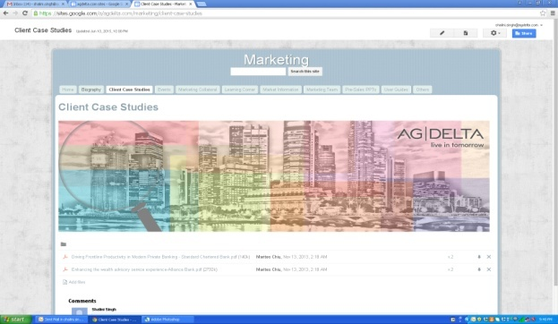
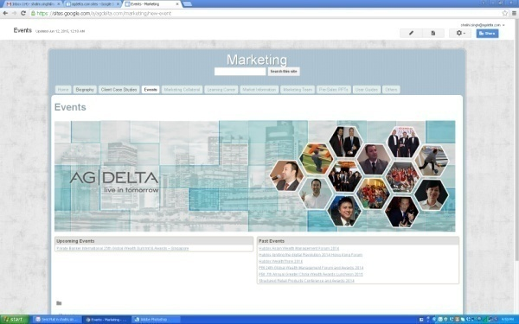
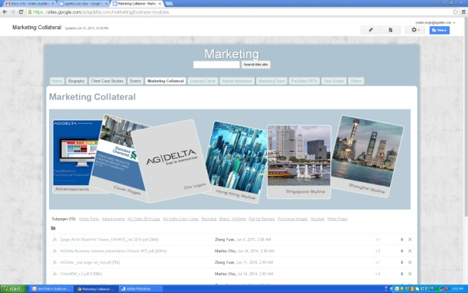
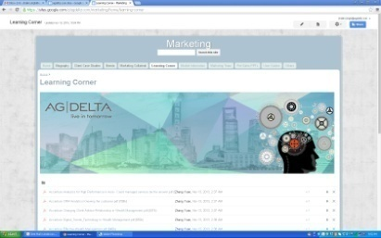
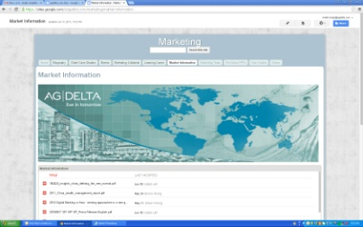
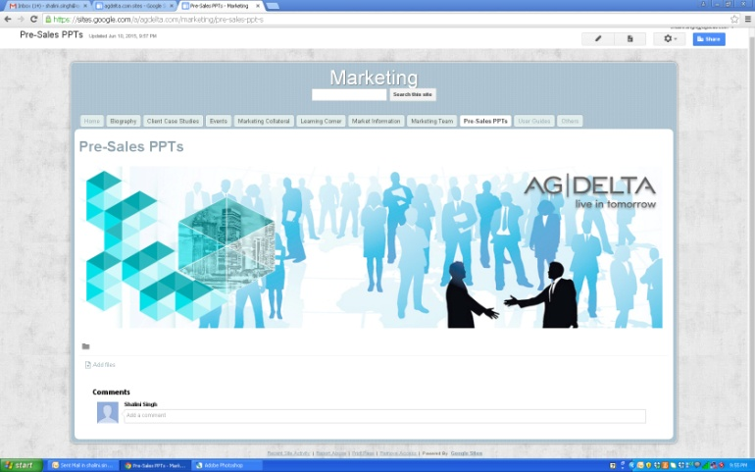
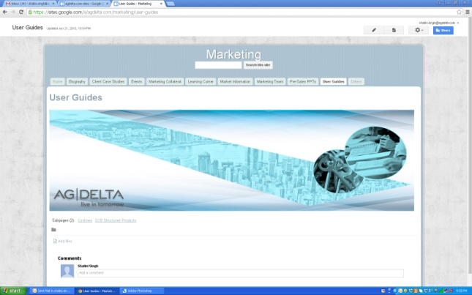
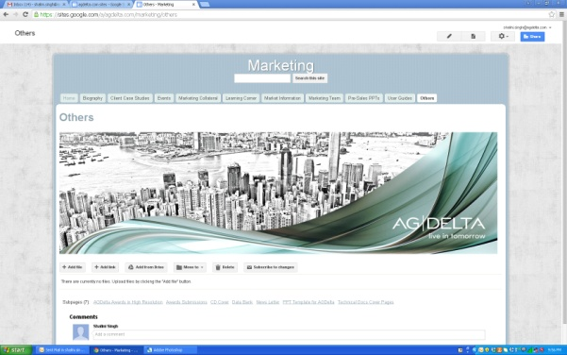
Google Website for Internal stake holders

Slide 8
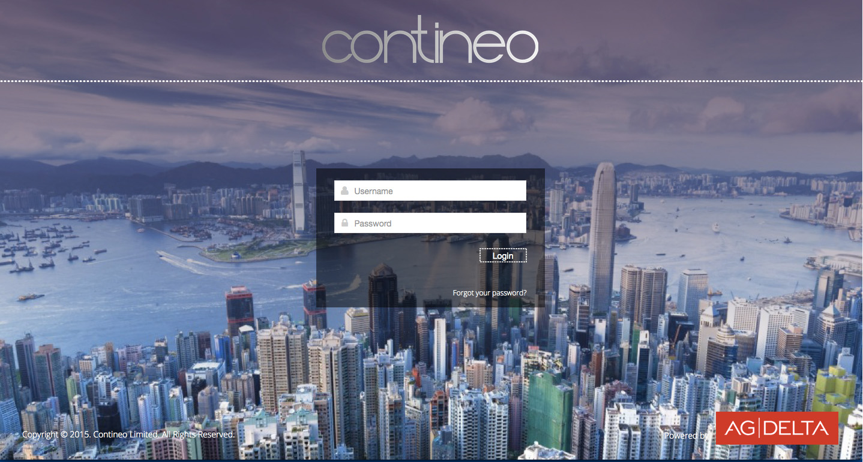
Login Screens for Contineo in Ecllipse (UI and Code)for the Web Apps

Slide 9
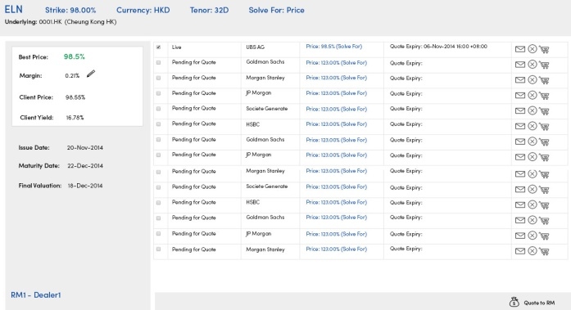
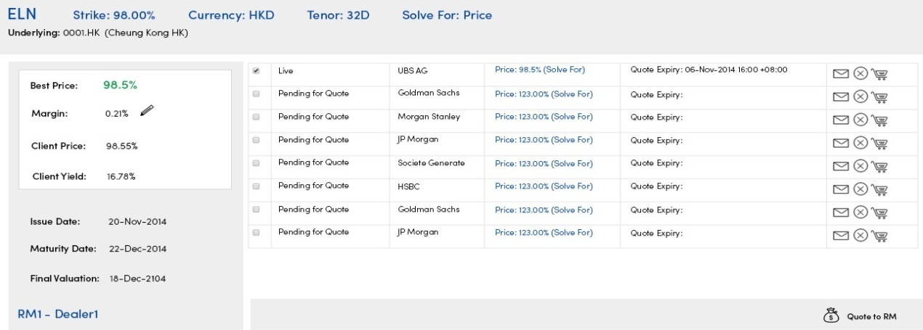
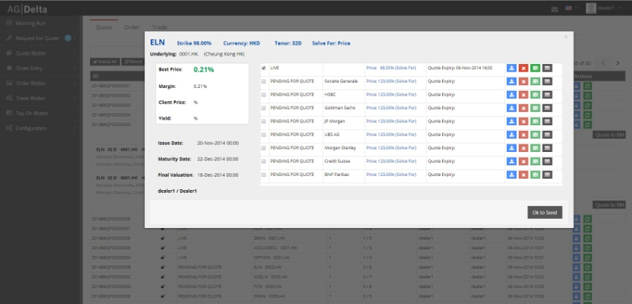
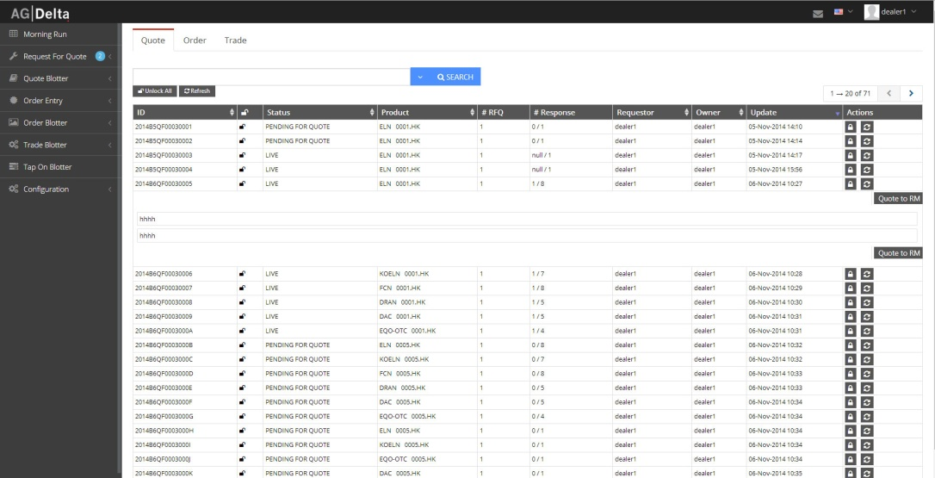
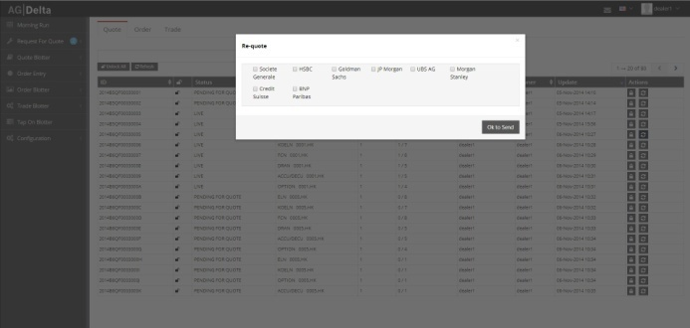
Product Screen design in Visualization, Jpg and Code for RM’s for Barclays
The above are done in JPG to get approval form Client
The below are coded in Eclipse using HTML 5, CSS3 and Angular JS JSON used for fetching date

Slide 10
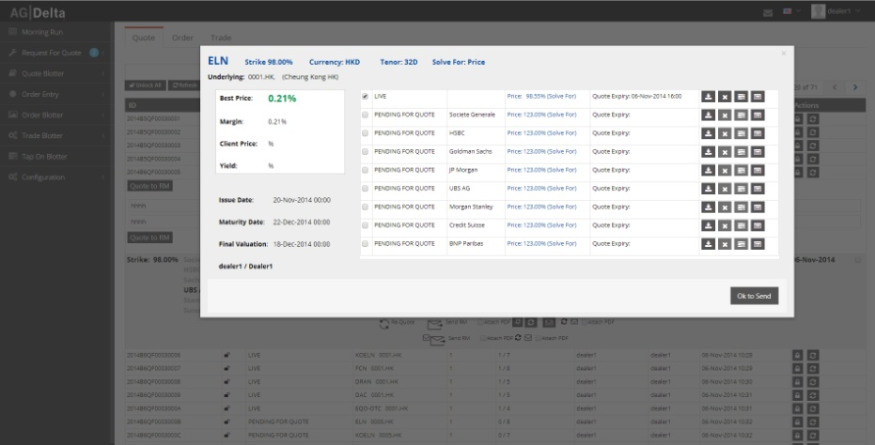
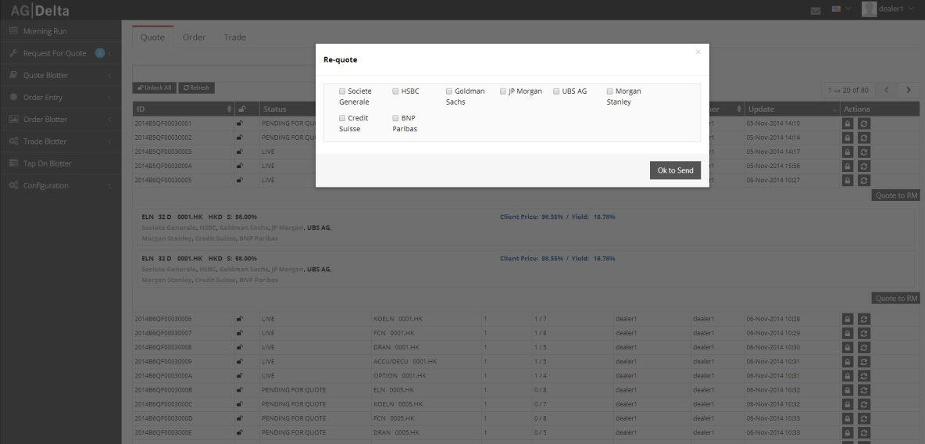
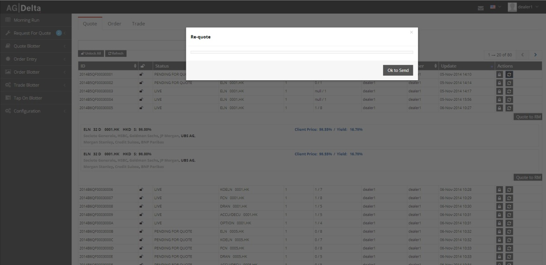
Product Screen Code for RM’s for Barclays

Slide 11
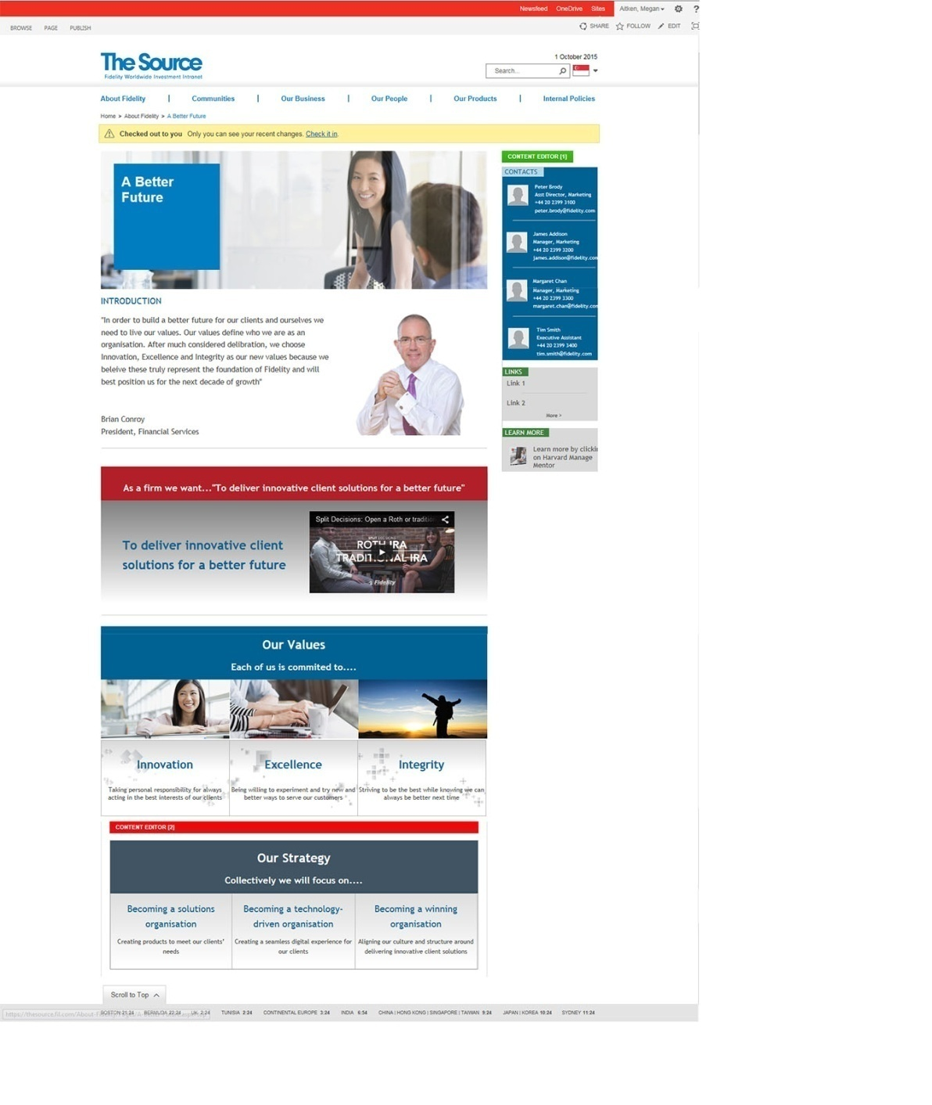
Sharepoint Website for Internal Stakeholders in Fidelity Investments

Slide 12
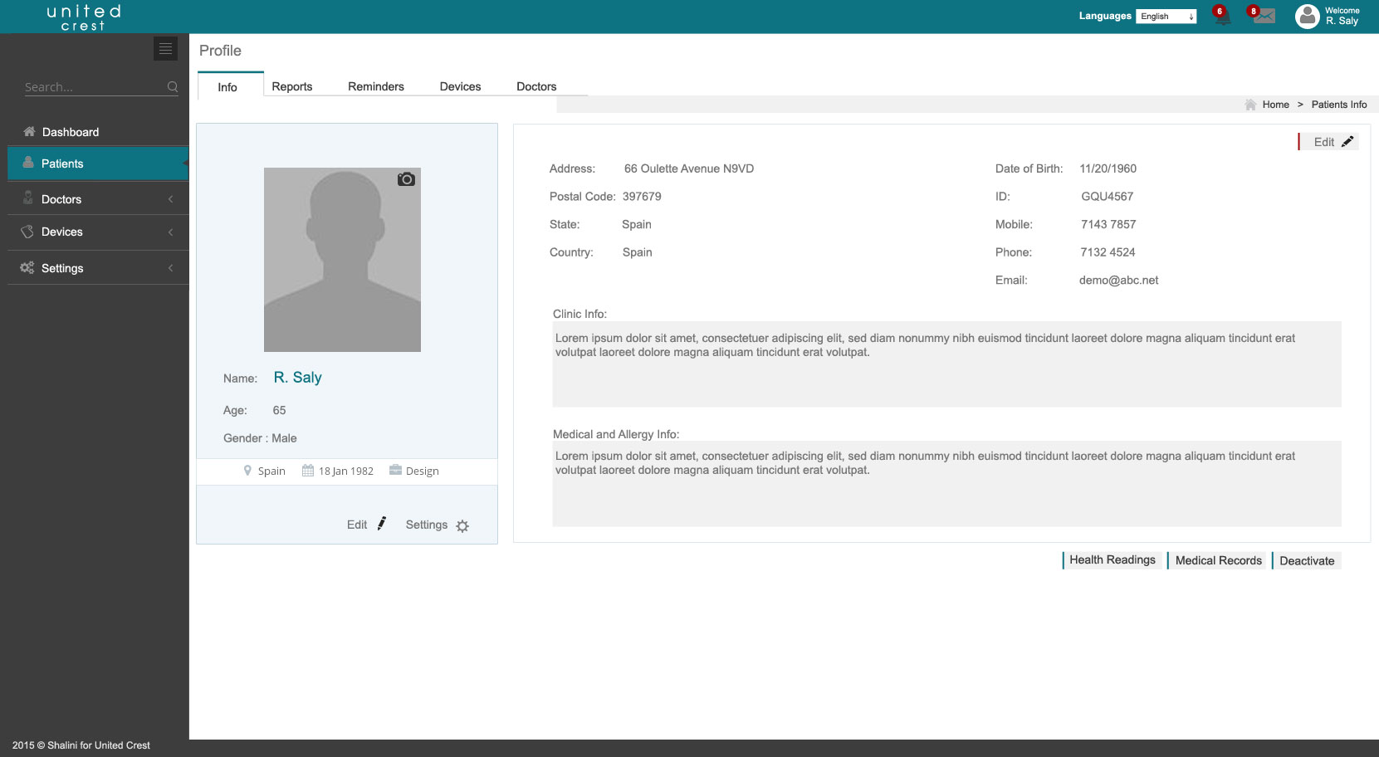
Web Apps Visual Layout for the Patients for the Healthcare Apps

Slide 13

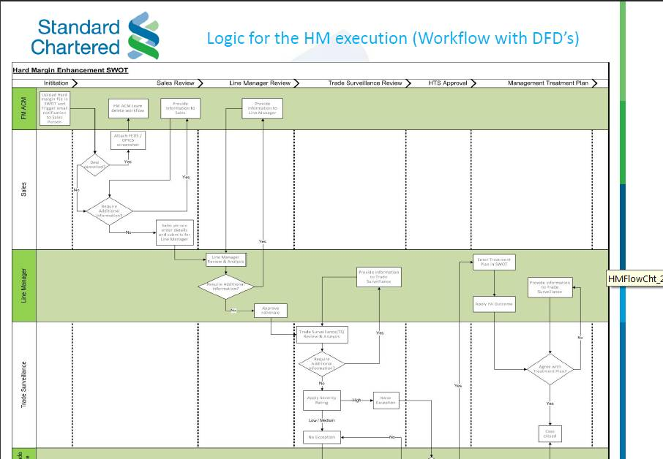
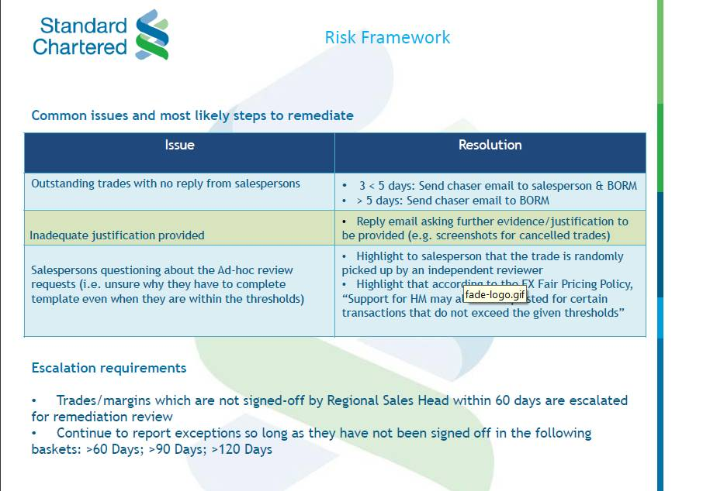

Presentation for Hard Margin explained in the work shop for the CEO’s for an
International Bank

Slide 14
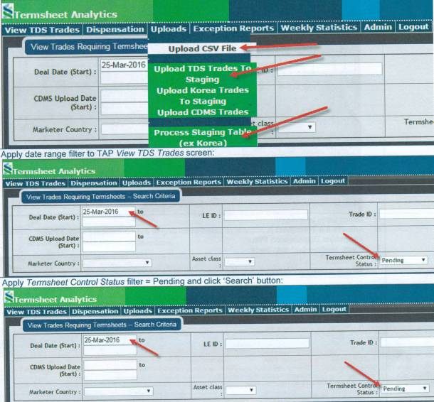
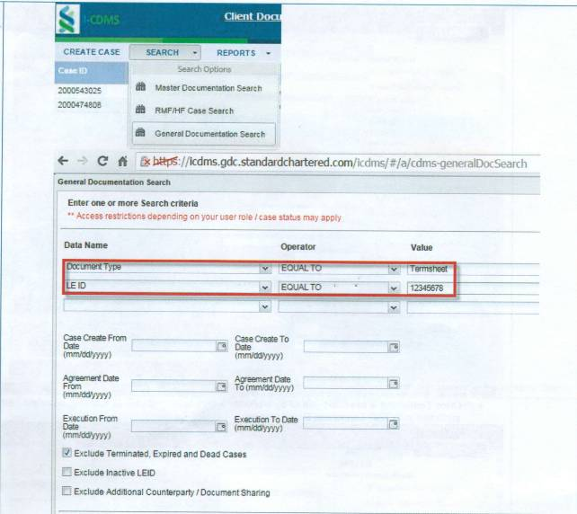
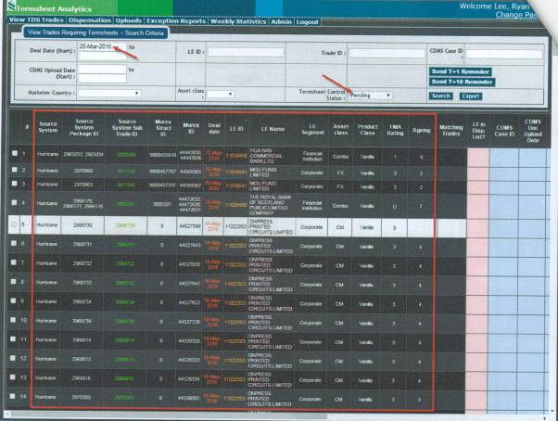
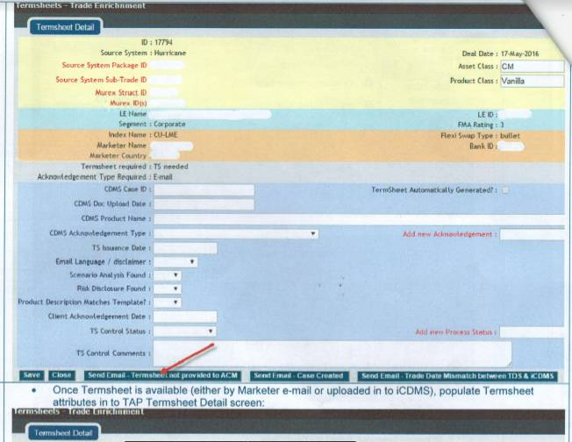
Web Apps for the Termsheet Completeness for an International Bank

Slide 15
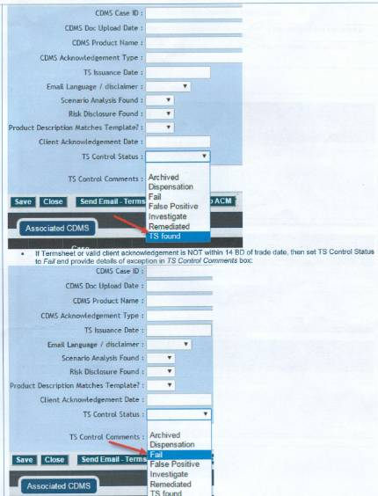
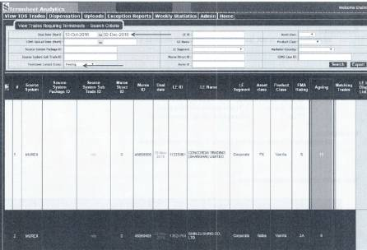
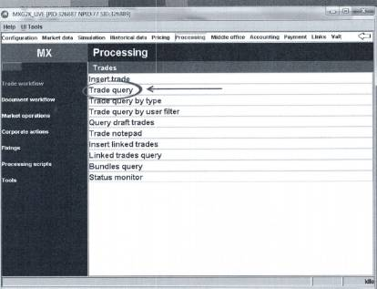
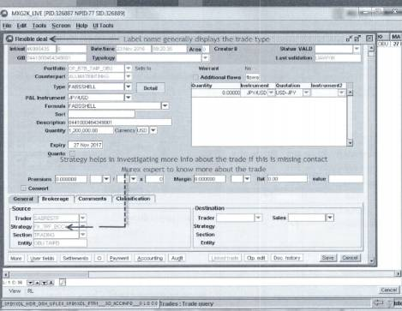

Web Apps for the Termsheet Completeness for an International Bank

Slide 16




Web Apps for the Govt Tech Project at Accenture

Slide 17





Web Apps for the Govt. Tech Project at Accenture

Slide 18




Web Apps for the Govt Tech Project at Accenture

Slide 19





CSV Screens delivered for a Leading Financial Institution Low Fidelity
design in Balasmiq

Slide 20



CSV Screens delivered for a Leading Financial Institution Low Fidelity
design in Balasmiq

Slide 21





CSV Screens delivered for a Leading Financial Institution High Fidelity
design in Figma

Slide 22





CSV Screens delivered for a Leading Financial Institution High Fidelity
design in Figma

Slide 23





CSV Screens delivered for a Leading Financial Institution High Fidelity
design in Figma

Slide 24


Screens delivered for a Media Co. High Fidelity mockup design in Adobe XD for CMS PopTv

Slide 25




Screens delivered for a Media Co. High Fidelity mockup design in Adobe XD for CMS PopTv

Slide 26


Developing and Maintaining for a Media Co. their Beebly website, an online library in Philippines

Slide 27


